Slide 1



Sports Analysis
View in Power BI

Slide 2
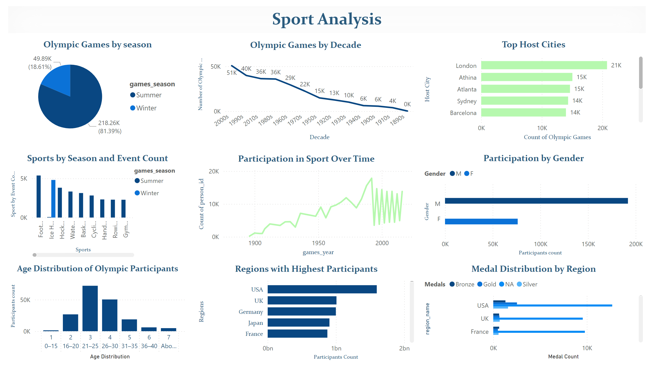
Dashboard
Notes:
Olympic Games by season
No alt text provided
Olympic Games by Decade
No alt text provided
Top Host Cities
No alt text provided
Sports by Season and Event Count
No alt text provided
Participation in Sport Over Time
No alt text provided
Participation by Gender
No alt text provided
Regions with Highest Participants
No alt text provided
Medal Distribution by Region
No alt text provided
Age Distribution of Olympic Participants
No alt text provided
textbox
No alt text provided

Slide 3
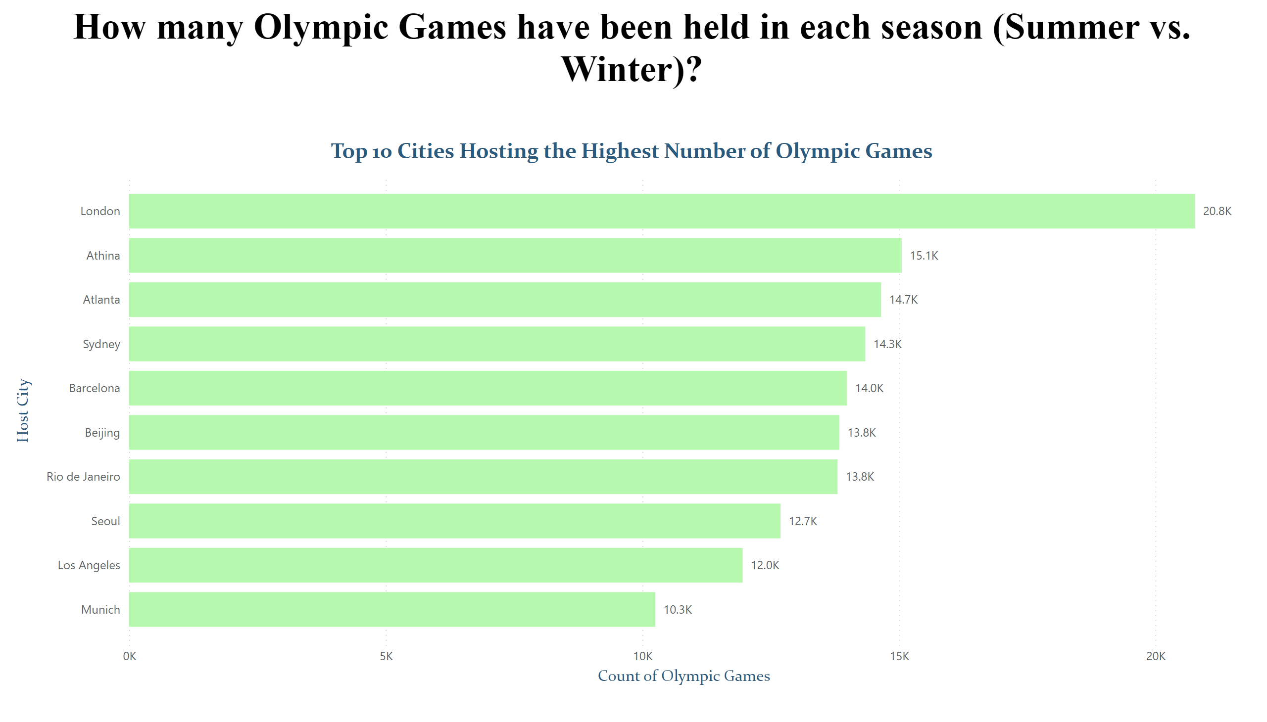
Page 1
Notes:
textbox
No alt text provided
Top 10 Cities Hosting the Highest Number of Olympic Games
No alt text provided

Slide 4
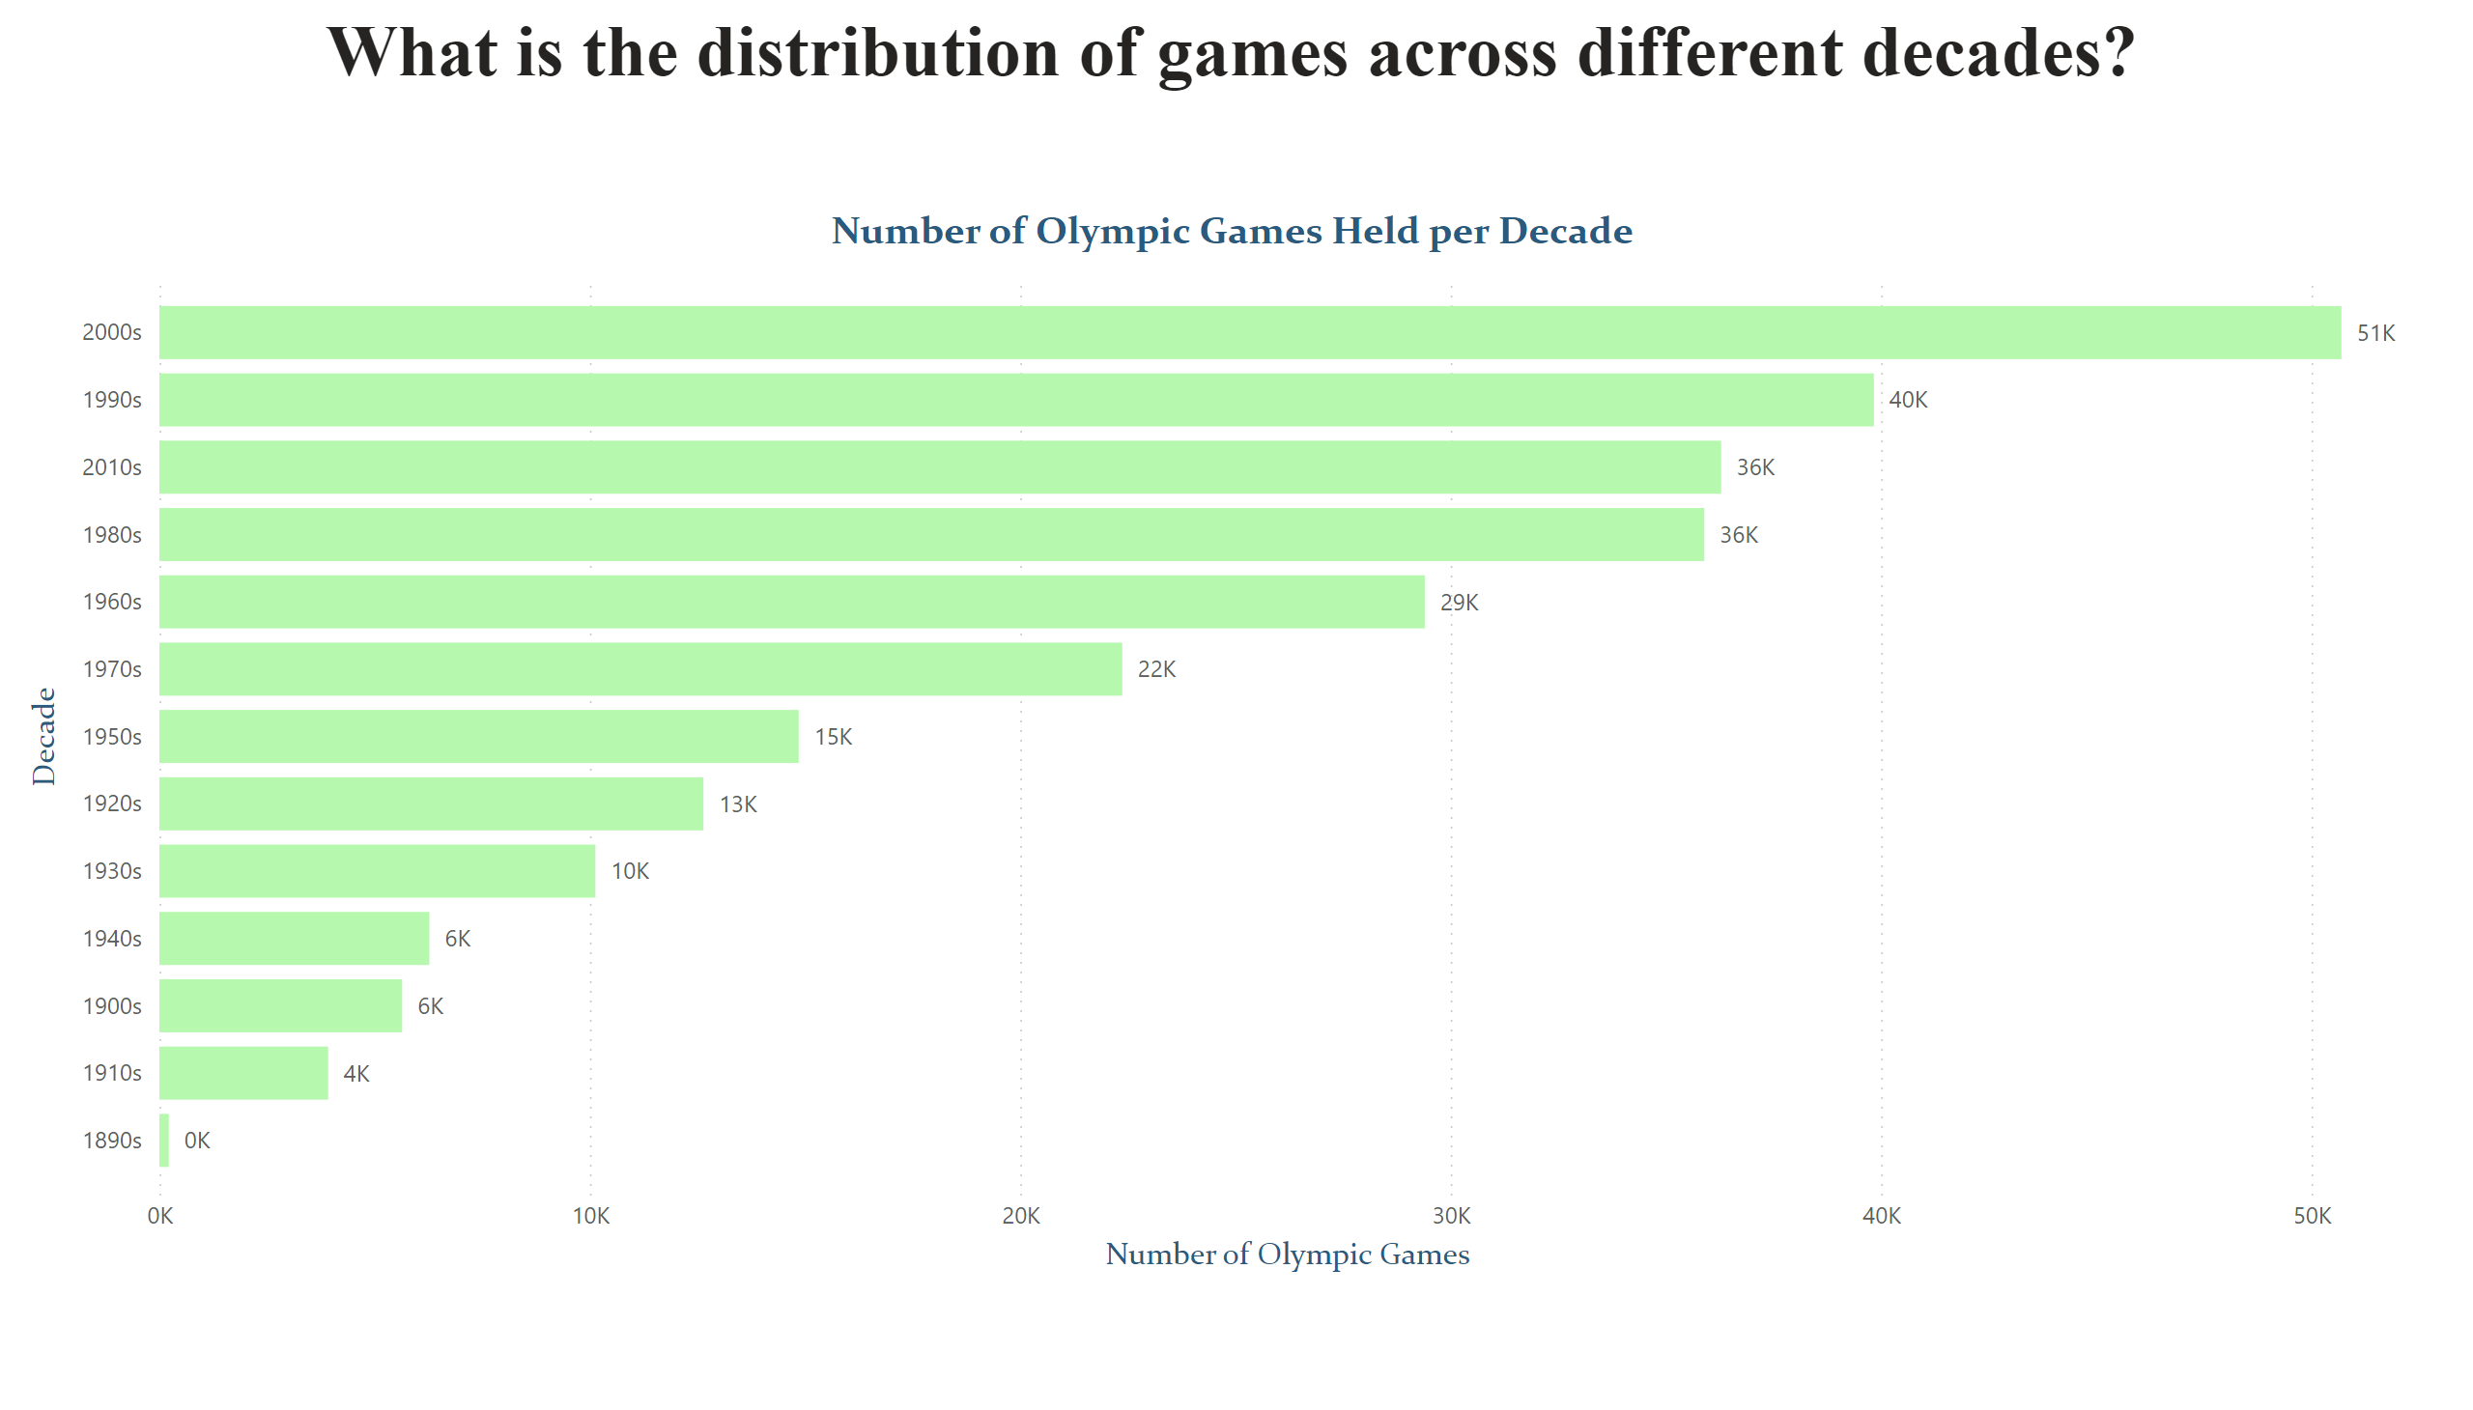
Page 2
Notes:
Number of Olympic Games Held per Decade
No alt text provided
textbox
No alt text provided

Slide 5
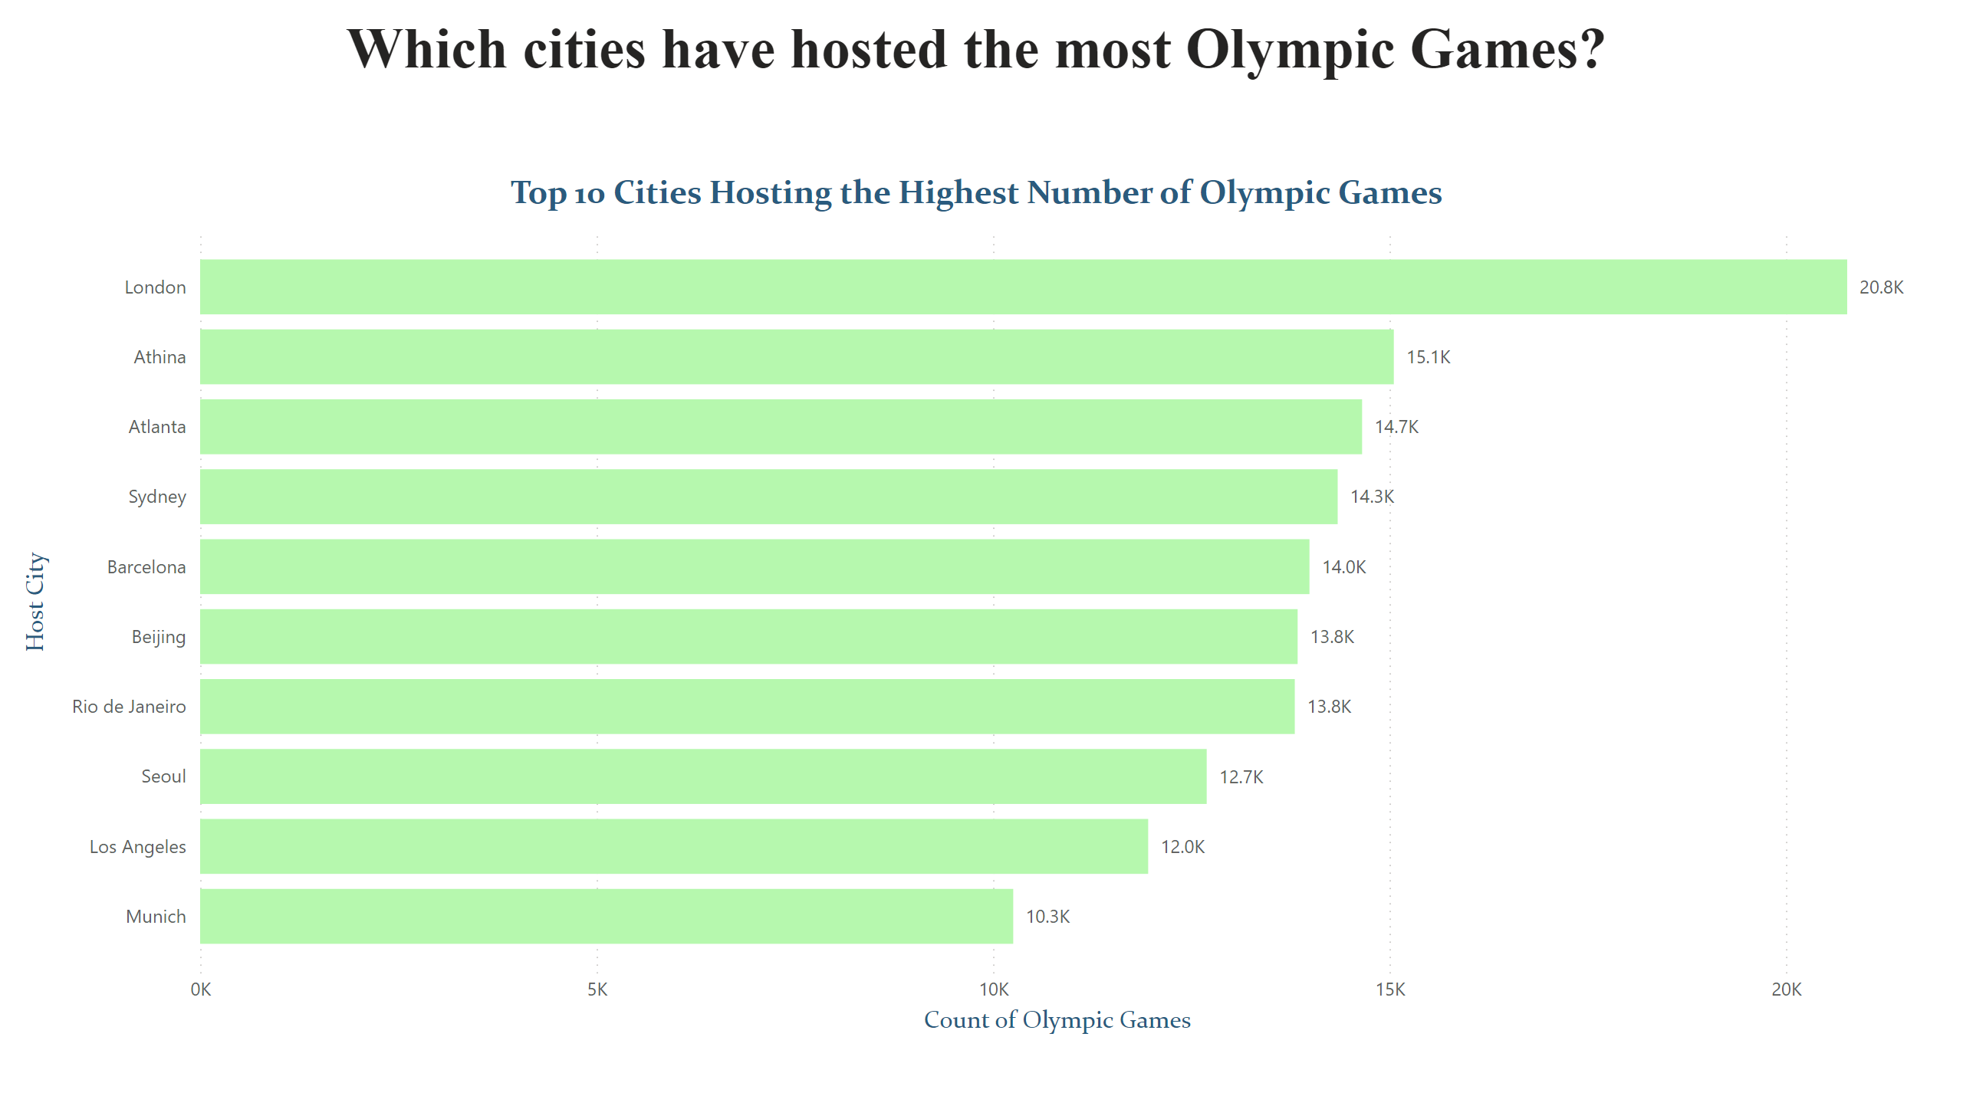
Page 3
Notes:
textbox
No alt text provided
Top 10 Cities Hosting the Highest Number of Olympic Games
No alt text provided

Slide 6
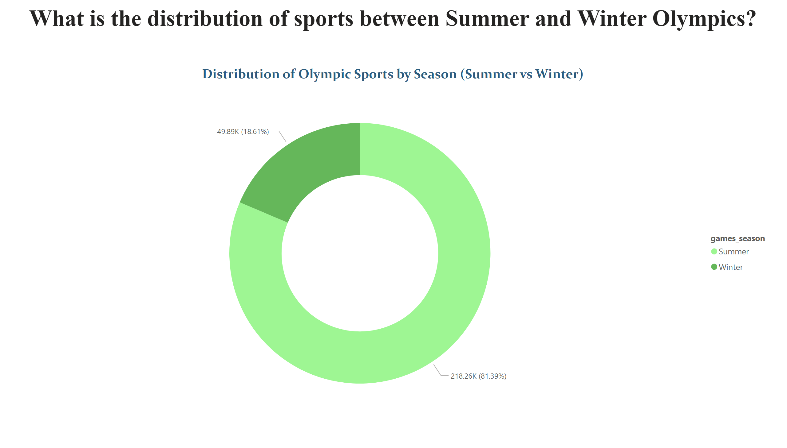
Page 4
Notes:
textbox
No alt text provided
Distribution of Olympic Sports by Season (Summer vs Winter)
No alt text provided

Slide 7
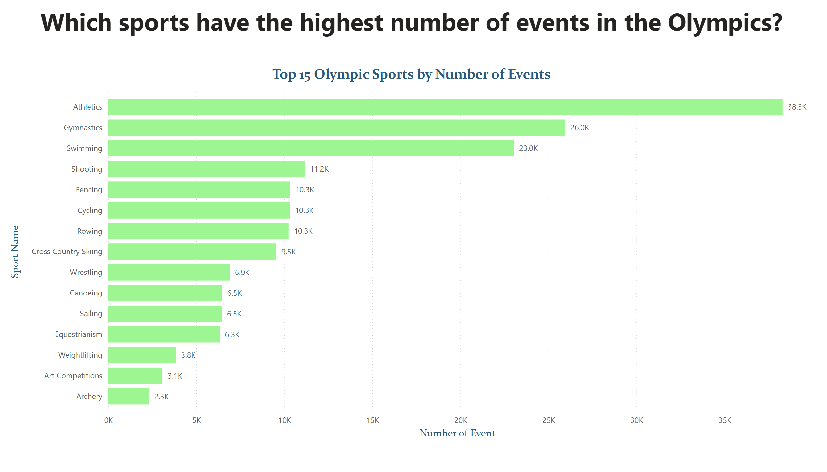
Page 5
Notes:
textbox
No alt text provided
Top 15 Olympic Sports by Number of Events
No alt text provided

Slide 8
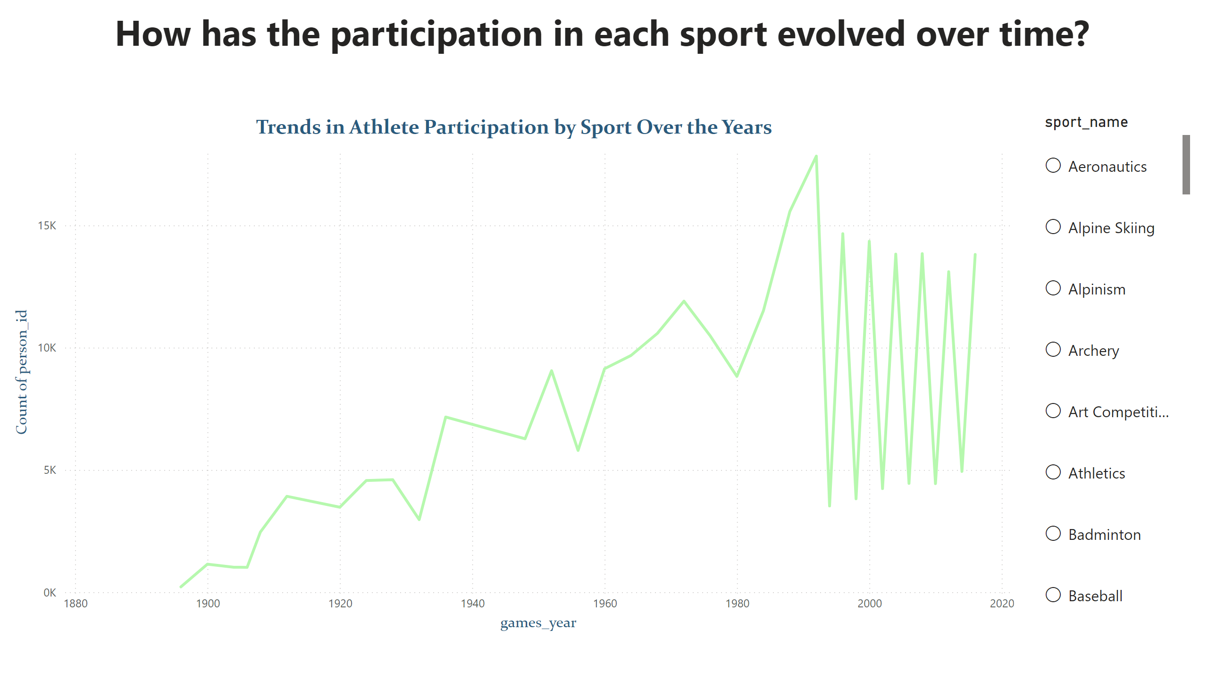
Page 6
Notes:
Trends in Athlete Participation by Sport Over the Years
No alt text provided
listSlicer
No alt text provided
textbox
No alt text provided

Slide 9
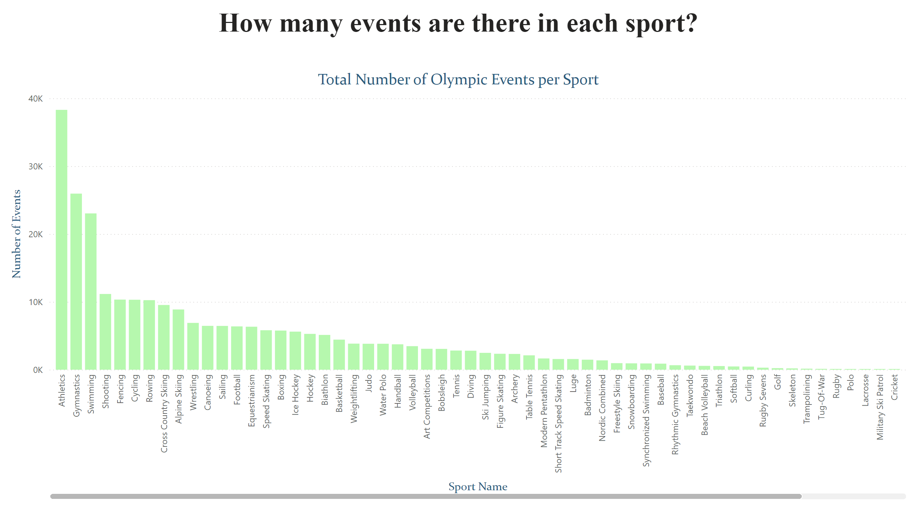
Page 7
Notes:
textbox
No alt text provided
Total Number of Olympic Events per Sport
No alt text provided

Slide 10
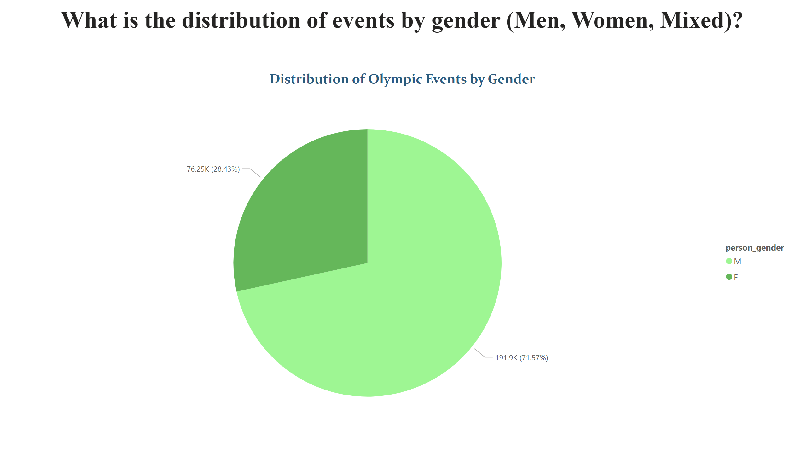
Page 8
Notes:
textbox
No alt text provided
Distribution of Olympic Events by Gender
No alt text provided

Slide 11
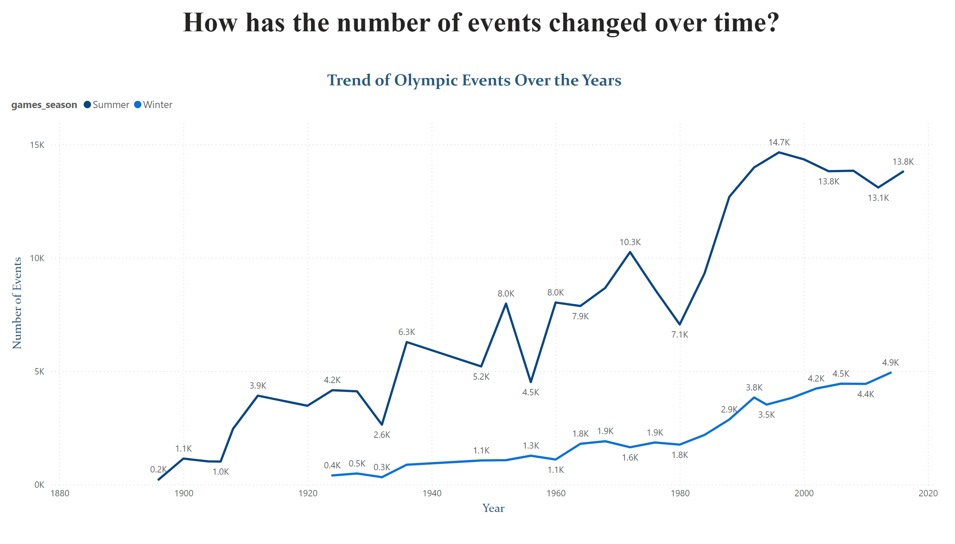
Page 9
Notes:
textbox
No alt text provided
Trend of Olympic Events Over the Years
No alt text provided

Slide 12
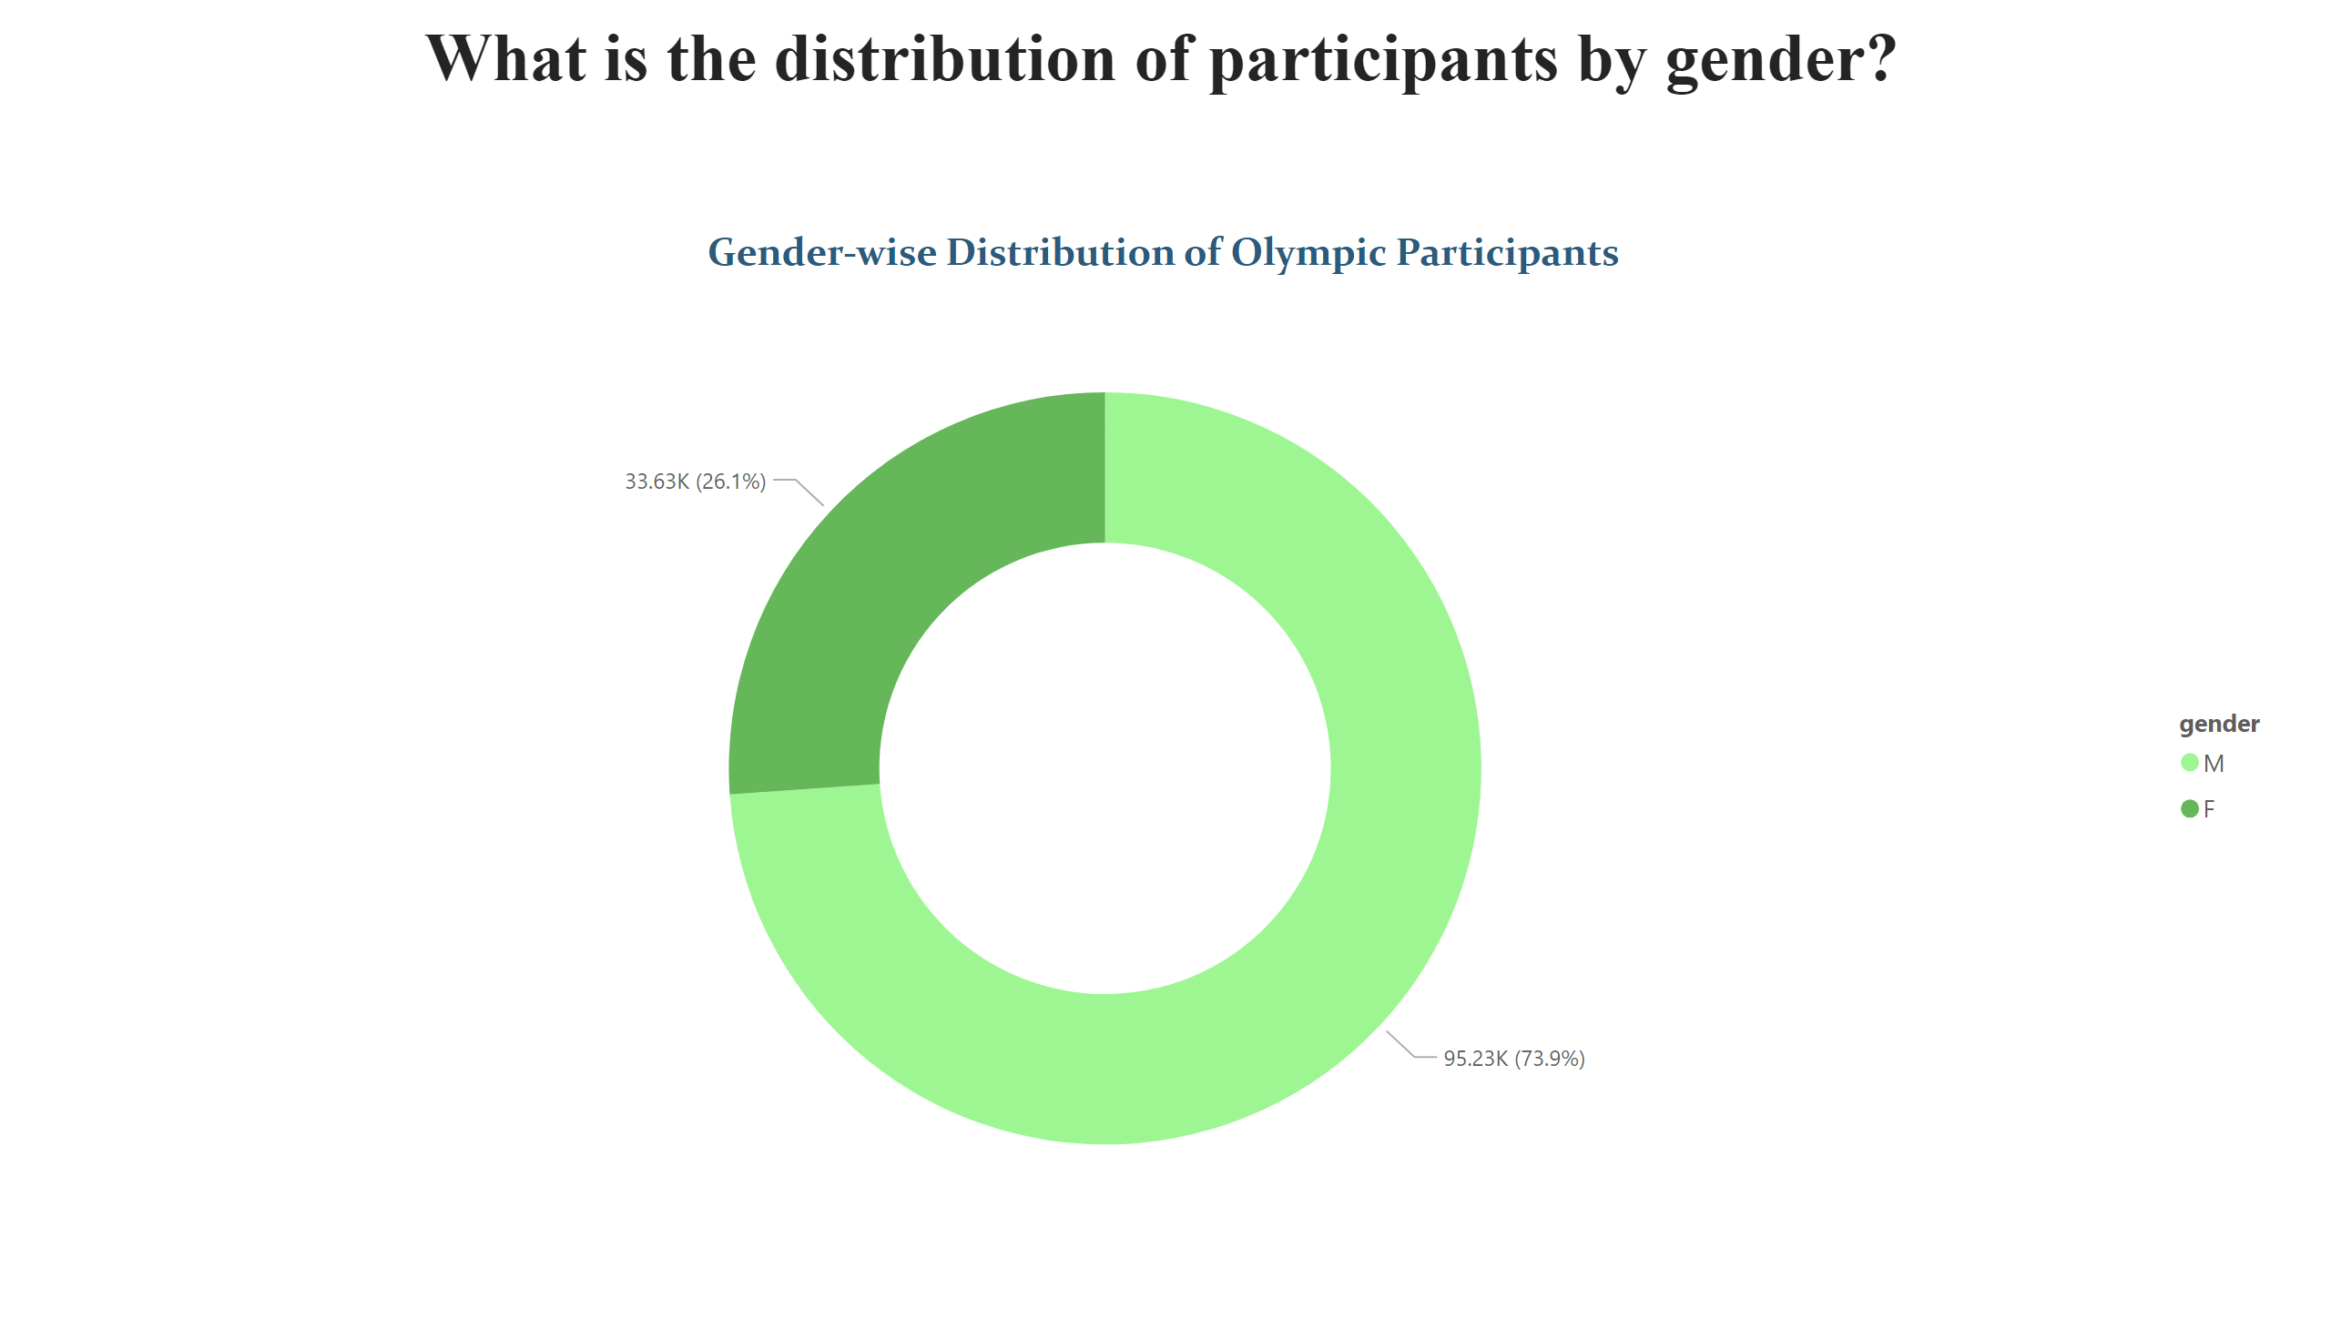
Page 10
Notes:
textbox
No alt text provided
Gender-wise Distribution of Olympic Participants
No alt text provided

Slide 13
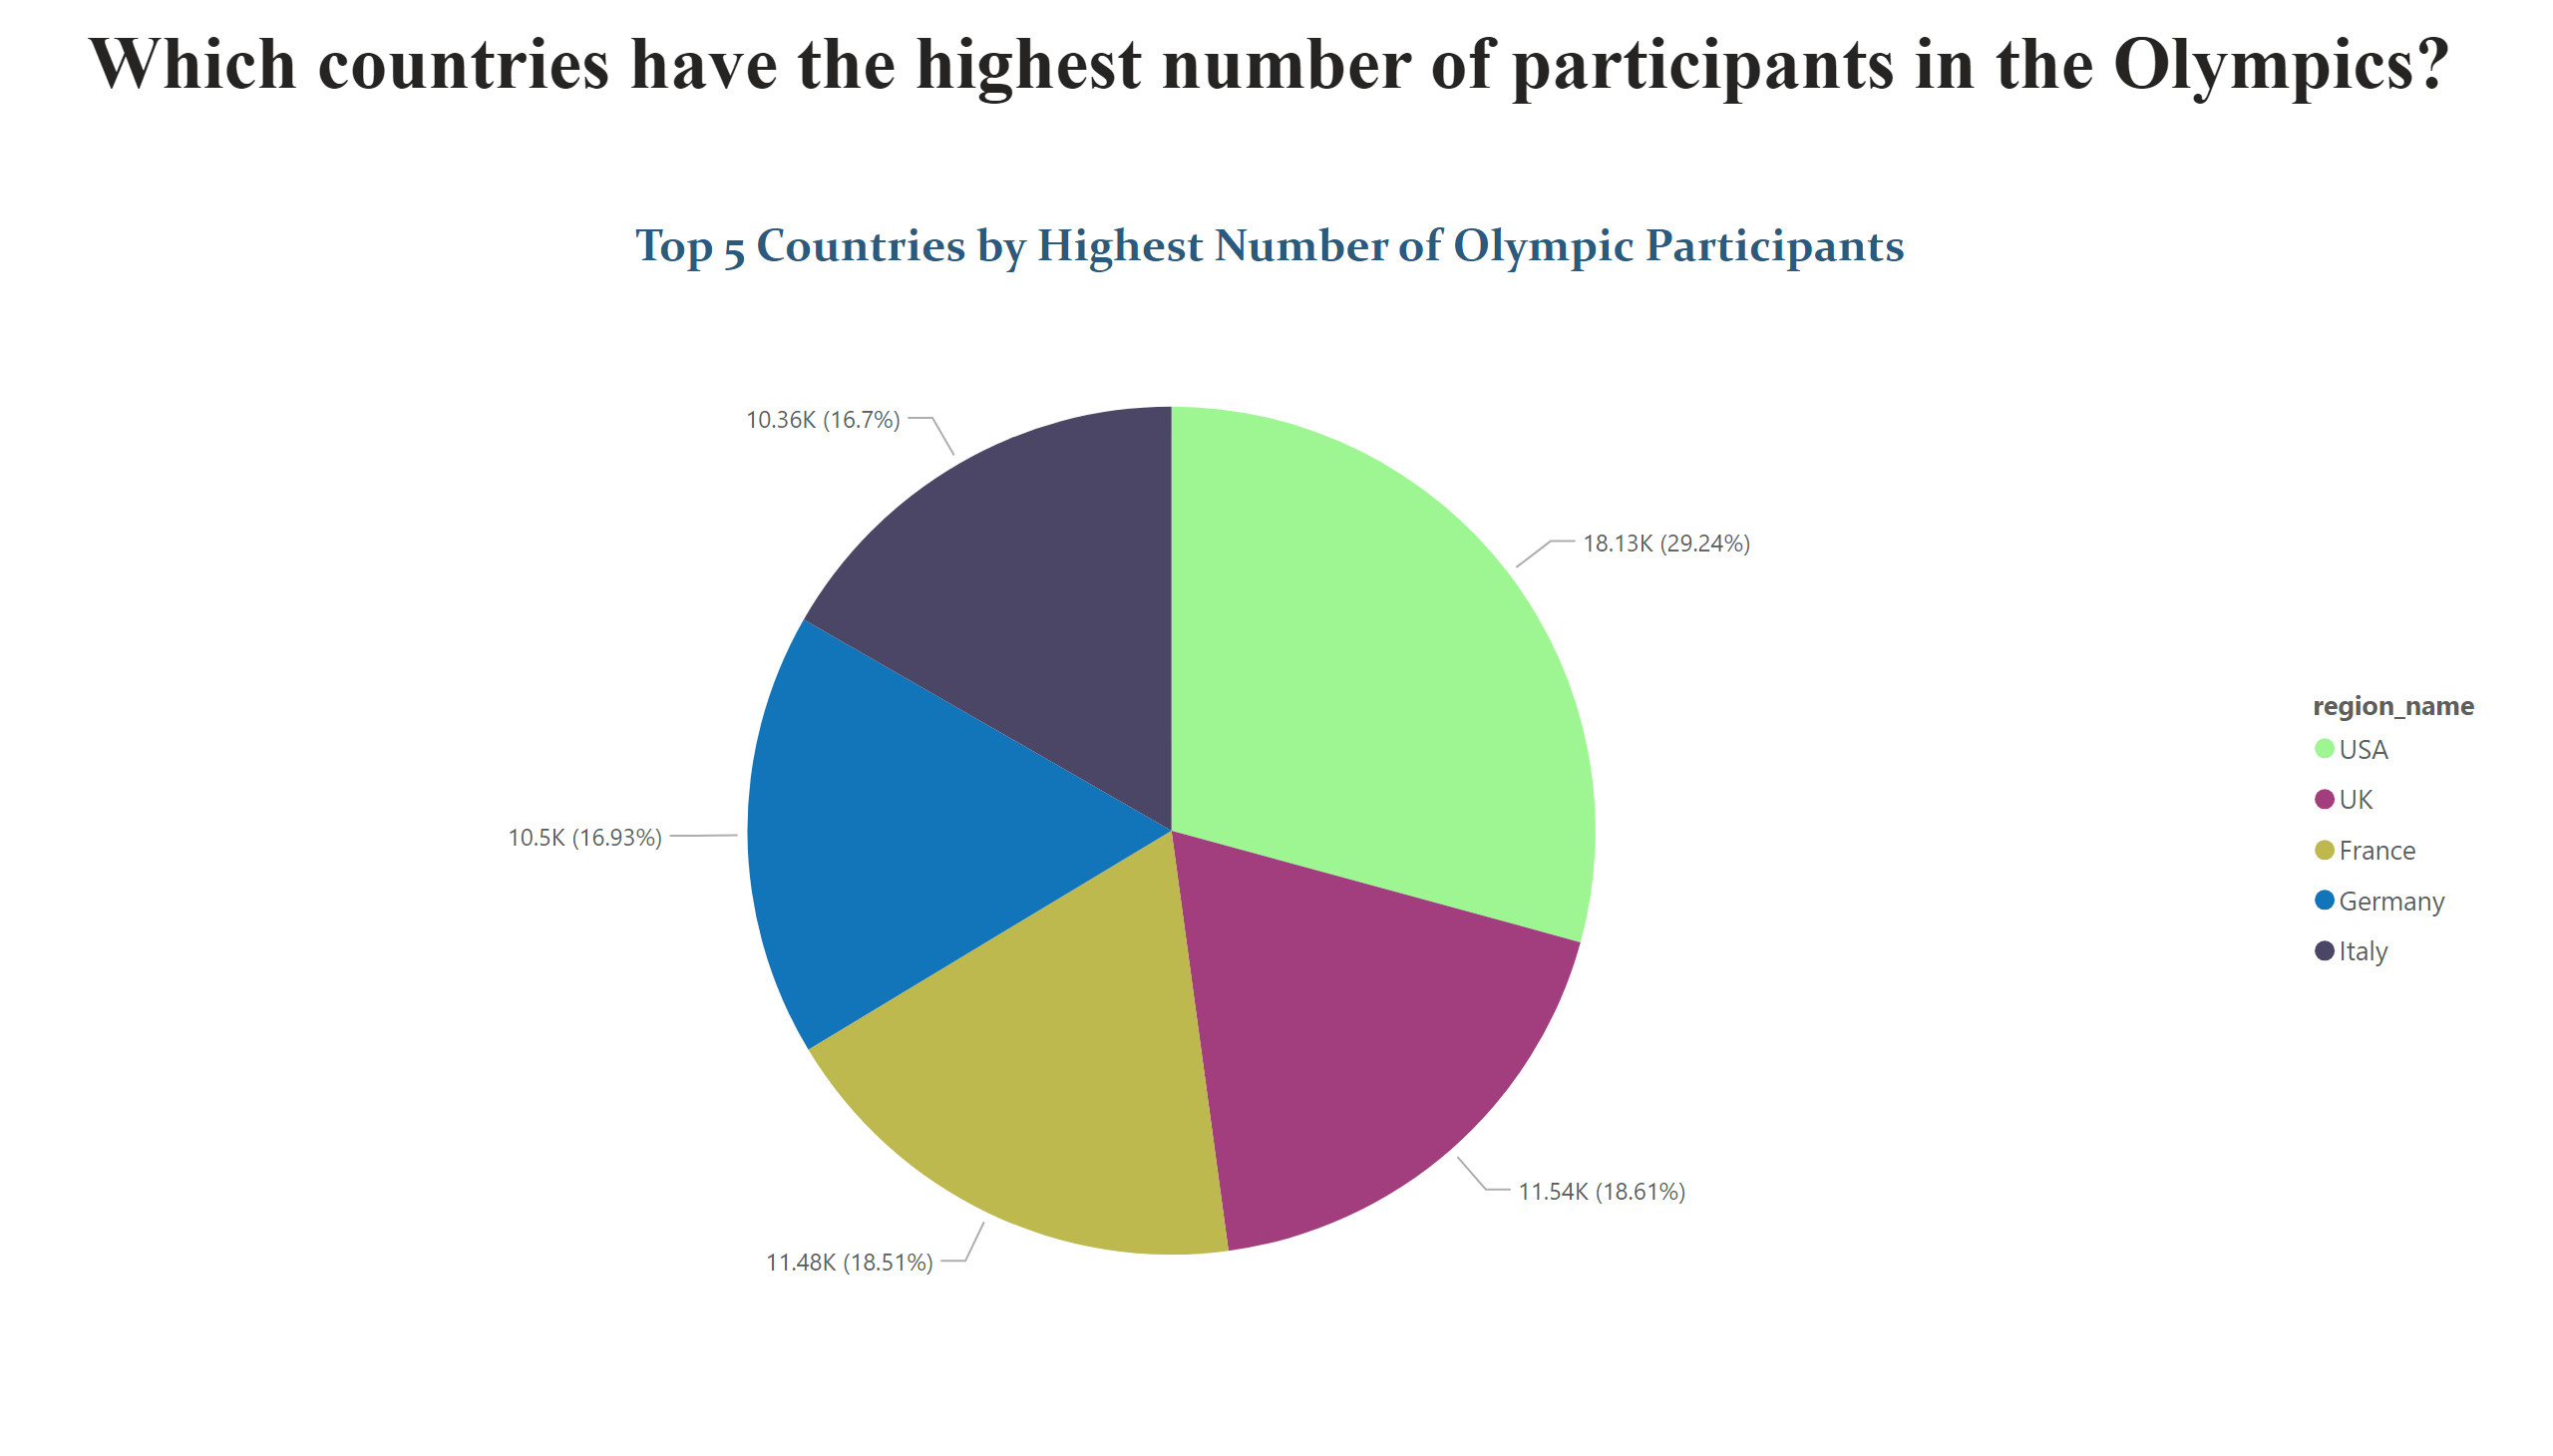
Page 11
Notes:
Top 5 Countries by Highest Number of Olympic Participants
No alt text provided
textbox
No alt text provided

Slide 14
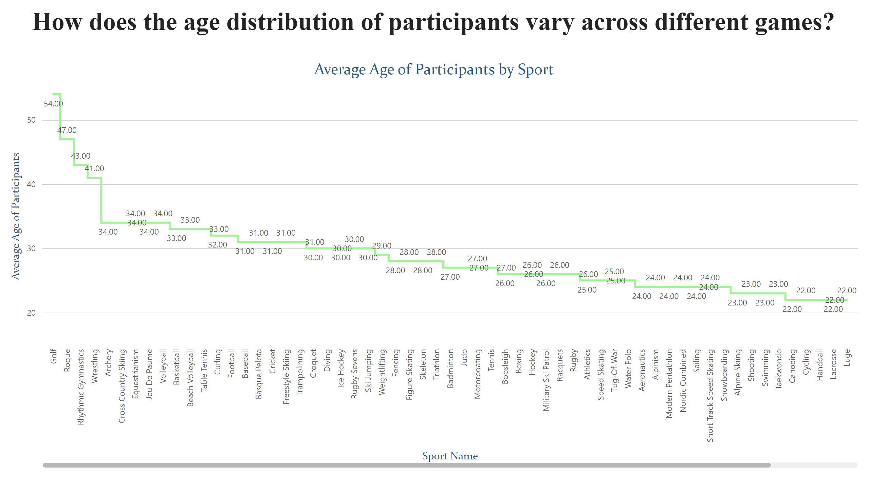
Page 12
Notes:
Average Age of Participants by Sport
No alt text provided
textbox
No alt text provided

Slide 15
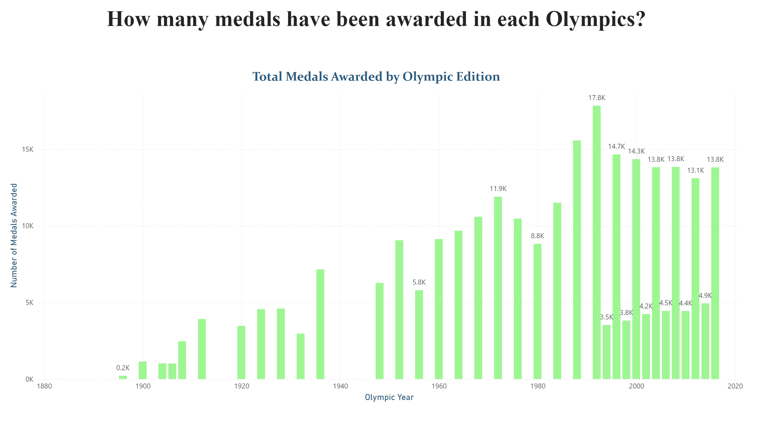
Page 13
Notes:
textbox
No alt text provided
Total Medals Awarded by Olympic Edition
No alt text provided

Slide 16
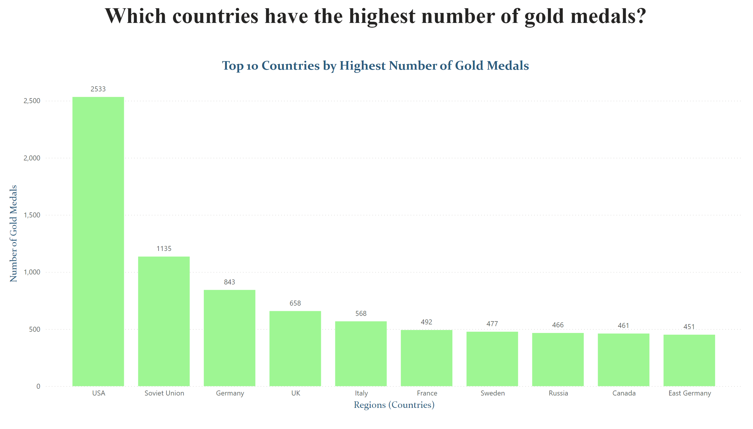
Page 14
Notes:
textbox
No alt text provided
Top 10 Countries by Highest Number of Gold Medals
No alt text provided

Slide 17
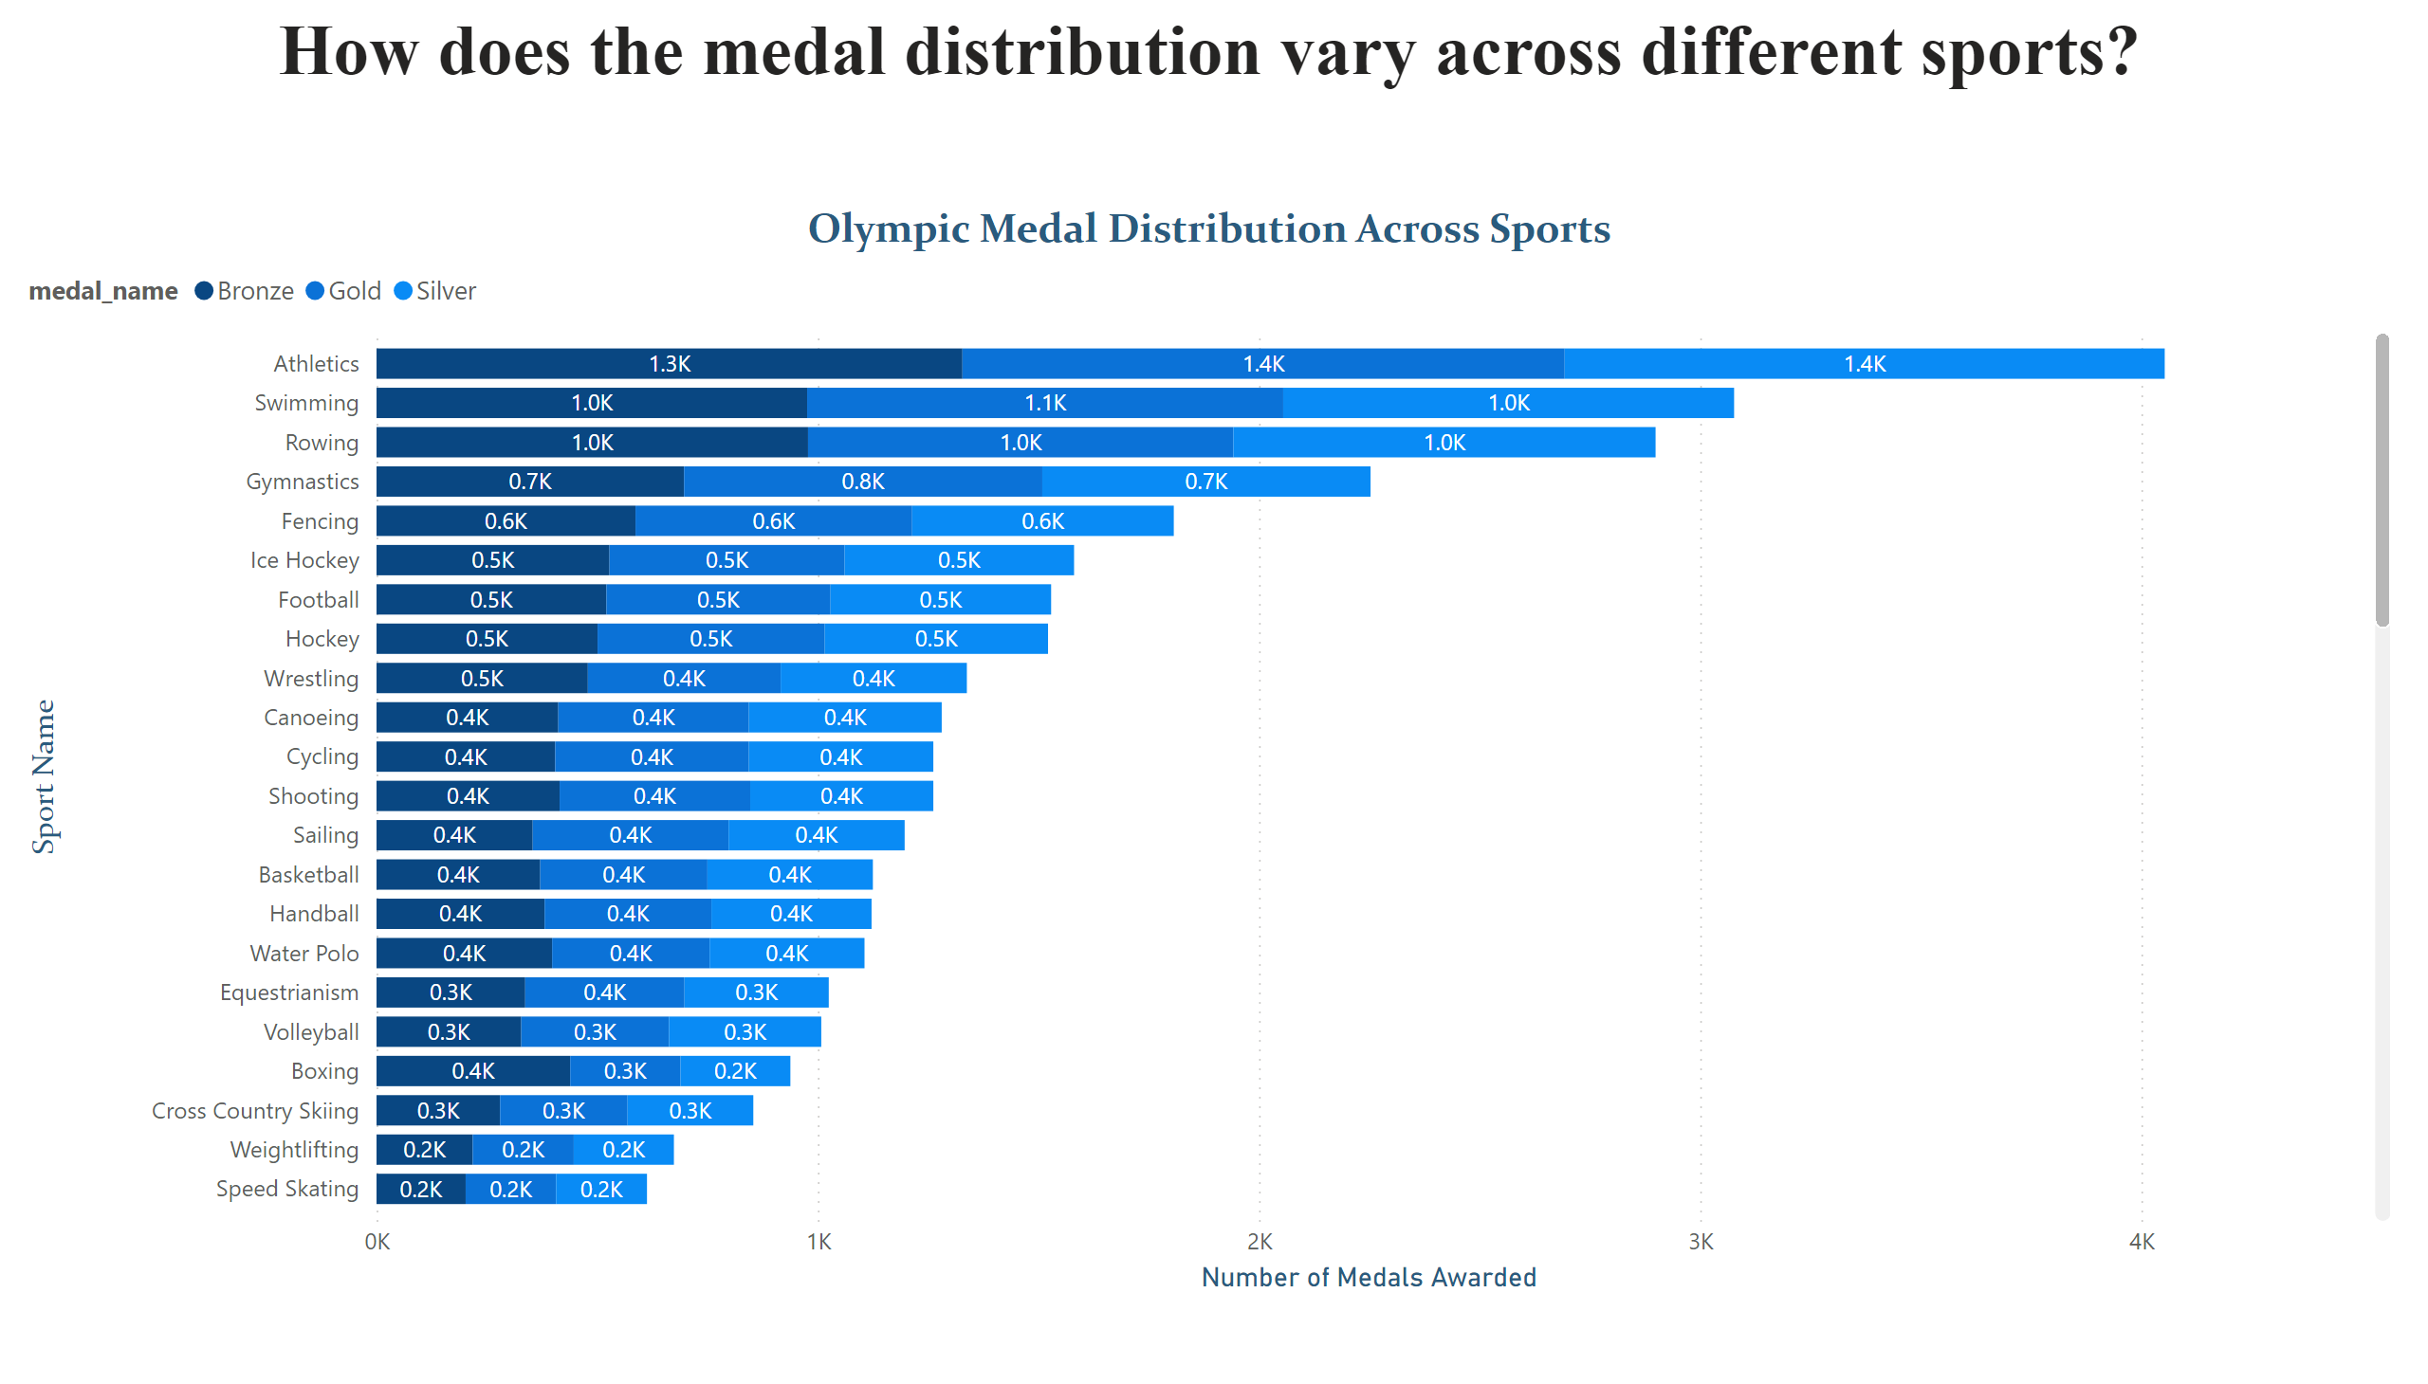
Page 15
Notes:
Olympic Medal Distribution Across Sports
No alt text provided
textbox
No alt text provided

Slide 18
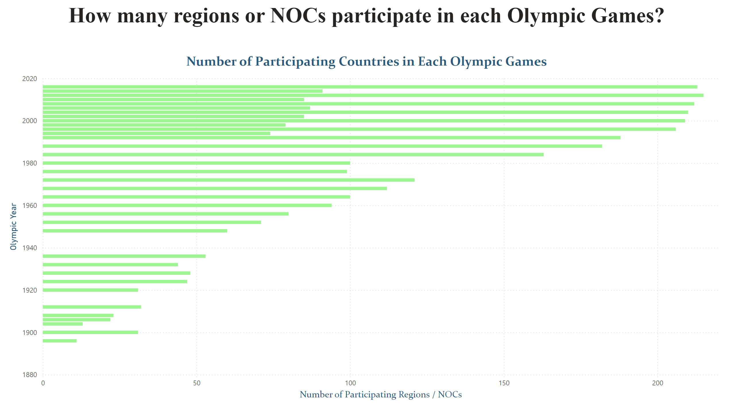
Page 16
Notes:
Number of Participating Countries in Each Olympic Games
No alt text provided
textbox
No alt text provided

Slide 19
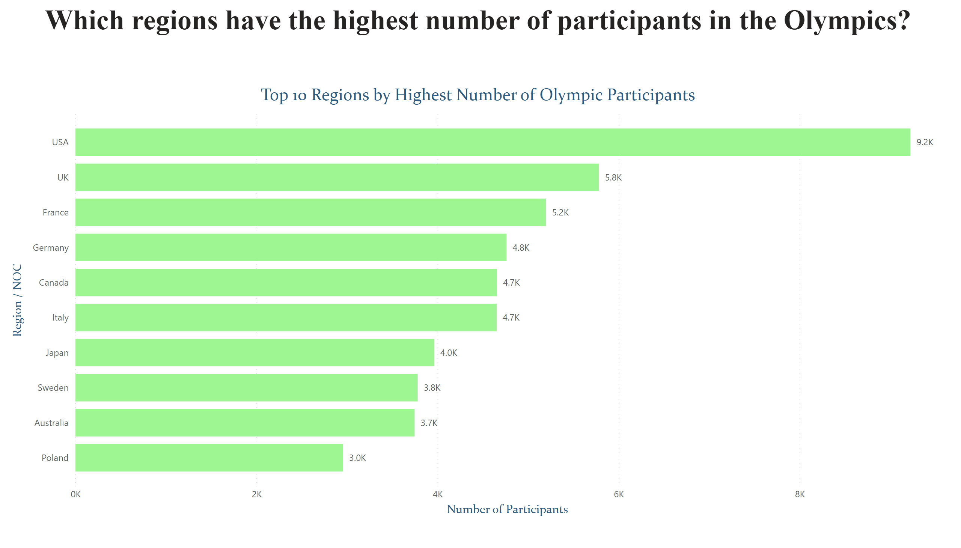
Page 17
Notes:
Top 10 Regions by Highest Number of Olympic Participants
No alt text provided
textbox
No alt text provided

Slide 20
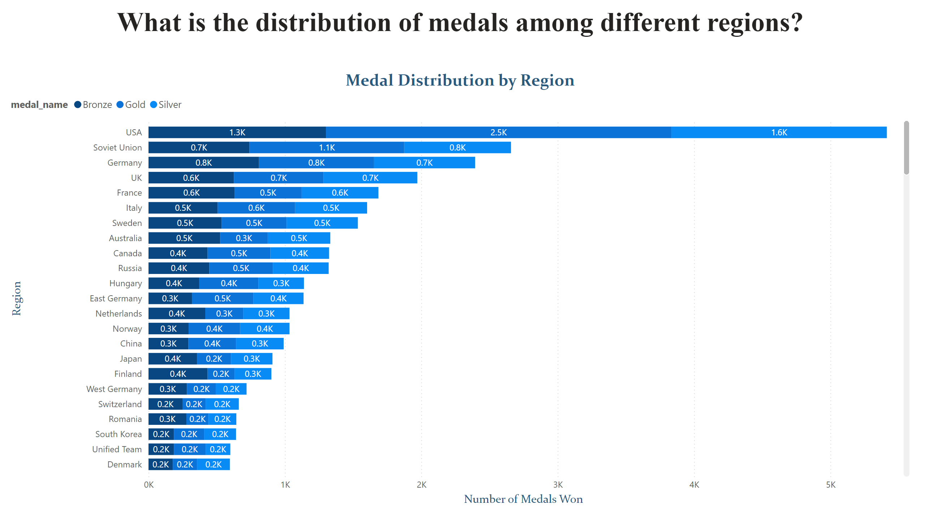
Page 18
Notes:
Medal Distribution by Region
No alt text provided
textbox
No alt text provided

